Slide 1

Mars Brew Co.
Team #1
Ivy Chiang, Tarun Kumar, Adam Zeigler
OPIM 5272: Data Management & Business Process Modeling
Date: 04/27/2021

Slide 2

Our Team
Adam Zeigler
Ivy Chiang
Tarun Kumar

Slide 3

Table of Contents
02
04
06
01
03
05
Pain Points and Motivations
Company Overview
Process Flow
Database Demo
Data Model
Conclusions
Pain Points and Motivations

Slide 4
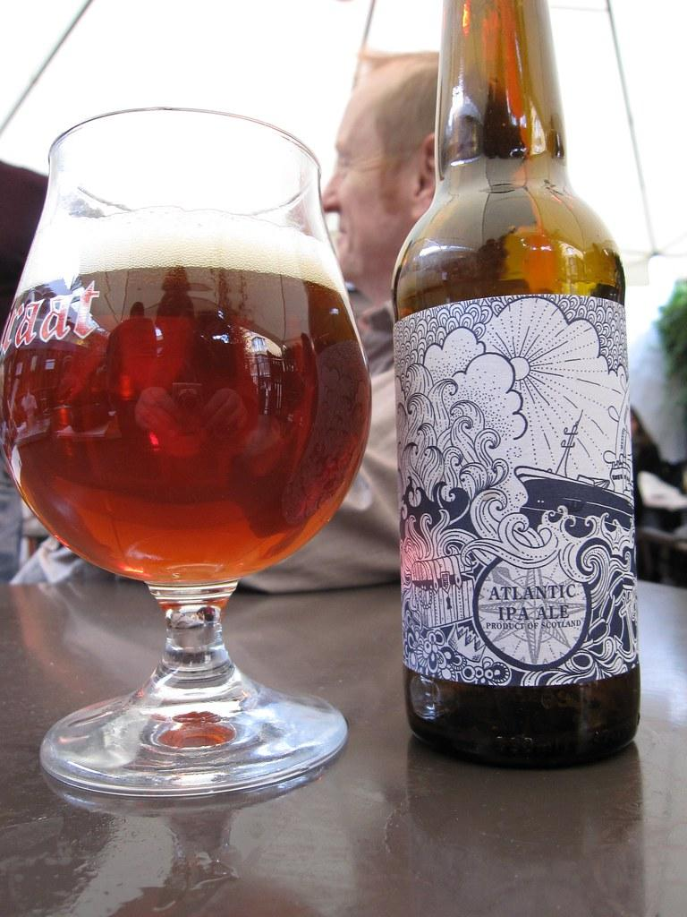
Company Overview
Mars Brew Co. is a local small batch brewery - Serves home crafted beer
Two product lines - IPA and Ale
Employee personnel overseeing procurement, manufacturing, distribution and customer service
For project purpose - Involvement limited to product distribution
Notes:
Overview of business: The business under discussion is a local small batch brewery. It serves customers home crafted beers in a restaurant set-up. It is a single brewery that serves two product lines - IPA and Ale. The business has employed several employees who take care distribution of the procurement, manufacturing, distribution, and customer service. However, for the purpose of the project, we have considered employee involvement limited to product distribution.

Slide 5
Pain Point and Motivations
Pain Point
Motivation
Maintain current inventory level based on customer demand
Better decision on raw material procurement and inventory based on accurate demand prediction
Notes:
Current challenges: The current challenge faced by the business is to maintain the current inventory levels based on customer demands. Hence, it is important for the company to have a system to predict incoming demand. Motivations: With the help of accurate demand prediction, the company will be better able to take decisions on raw material procurements and inventory. It will in turn will reduce procurement and inventory holding costs. In addition, the mechanism will help to serve customers better via an efficient supply chain.

Slide 6
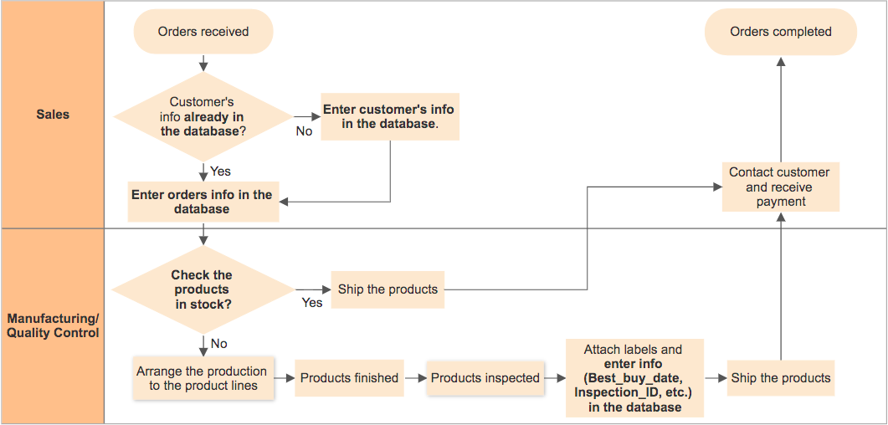
Process Flow
Notes:
Review process and swimlane?

Slide 7

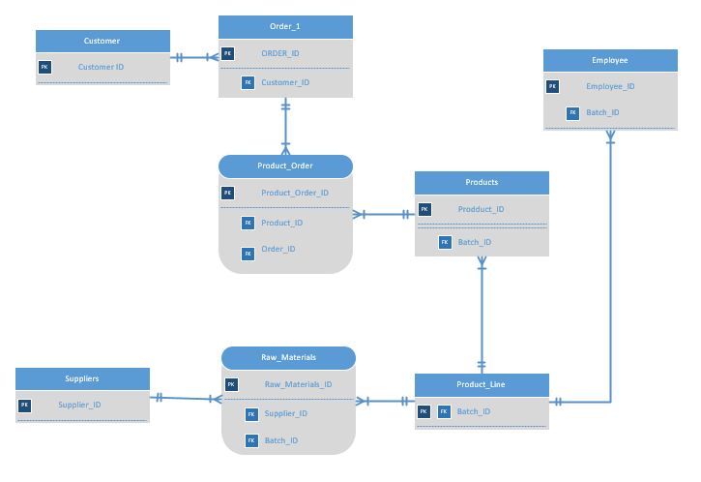
Data Model
Notes:
Database Structure: The data has been stored in the several tables and are connected with the RDBMS. The details of the tables are given below: Customer - It contains the information of the customer that placed an order including customer ID Order_1 - It includes order content, order ID and order date Product_Order - It comprises of the details of product required as part of the order placed Products - It has details of the products offered by the company Product_Line - It contains information of the product lines Employee- The table contains basic information of the company employees Raw_Materials- It encompasses details of the raw materials procured Suppliers- Includes basic information of the suppliers
Data base users?

Slide 8

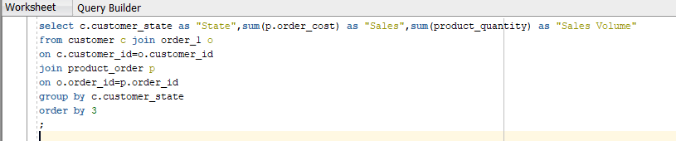
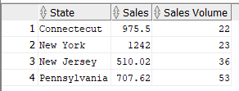
Database Demo: Report 1
Notes:
This report displays customer state, sum of order costs, and sum of the amount that was ordered. Grouped by state dn ordered by the sum of the orders. This Gives insight into where we are shipping our product and what states are generating the most money in sales. This could be used to identify states that should be targeted for upselling or where to focus promotions and advertising.

Slide 9
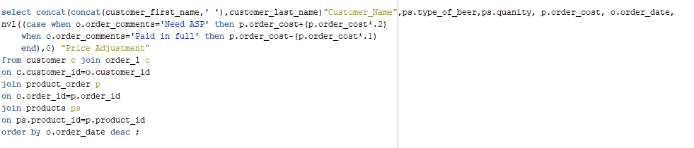
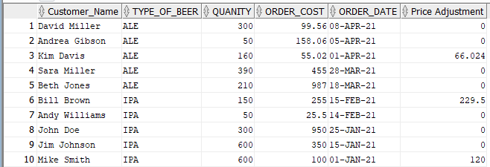
Database Demo:Report 2

Slide 10

Conclusions
Eliminate potential mistakes by using reliable information to make right decisions
Maintain the optimal inventory level to reduce the procurement and inventory holding costs
Improve the efficiency of production and shipment to reduce wasted time and costs

Slide 11
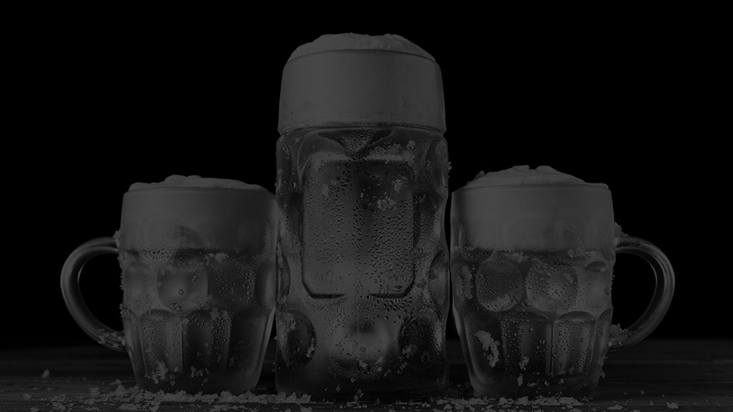
Thanks

